Slide 1

What Is Random Forest?

Slide 2
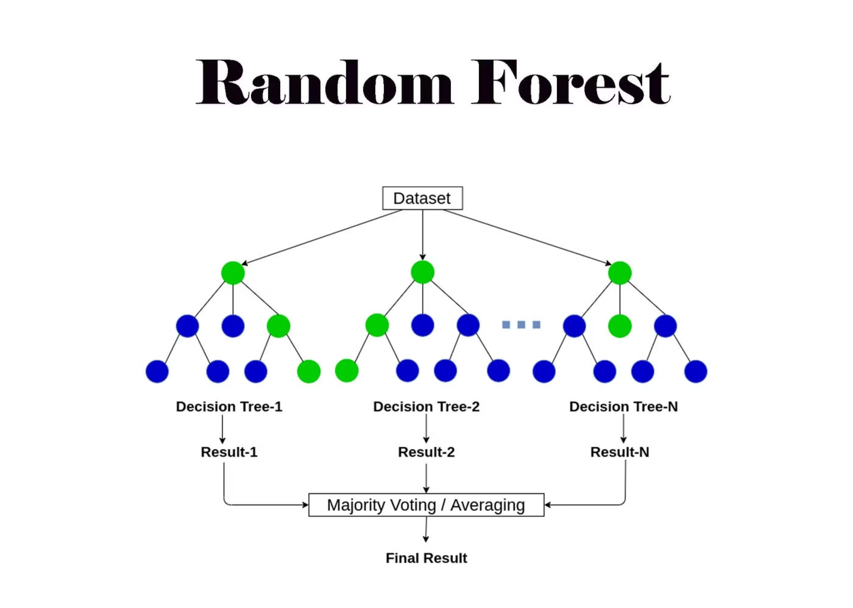
What Is Random Forest?
Random Forest is a powerful ensemble learning algorithm that combines the strength of multiple decision trees to make predictions. It works seamlessly for both classification and regression tasks, making it one of the most versatile tools in machine learning.
Ensemble Learning
Combines multiple models to create stronger predictions than any single model alone
Multiple Decision Trees
Built from many independent decision trees working together as a unified system
Dual Purpose
Handles both classification problems and regression tasks with equal effectiveness

Slide 3

Why Random Forest Was Developed
The Problem
Single decision trees, while intuitive and easy to interpret, face significant challenges in real-world applications:
They tend to overfit training data, memorizing noise instead of learning patterns
Small changes in training data can drastically alter the tree structure
Predictions often lack stability and reliability
The Solution: Random Forest was created to address these fundamental weaknesses by harnessing the wisdom of crowds—combining many trees to cancel out individual errors and create robust, stable predictions.

Slide 4



Core Idea of Random Forest
Train Many Trees
Create hundreds or thousands of decision trees, each learning from the data independently
Add Diversity
Each tree sees a random subset of data and features, ensuring unique perspectives
Combine Results
Aggregate predictions through voting (classification) or averaging (regression)
"The forest is wiser than any single tree. By introducing controlled randomness and combining diverse predictions, Random Forest transforms weakness into collective strength."

Slide 5
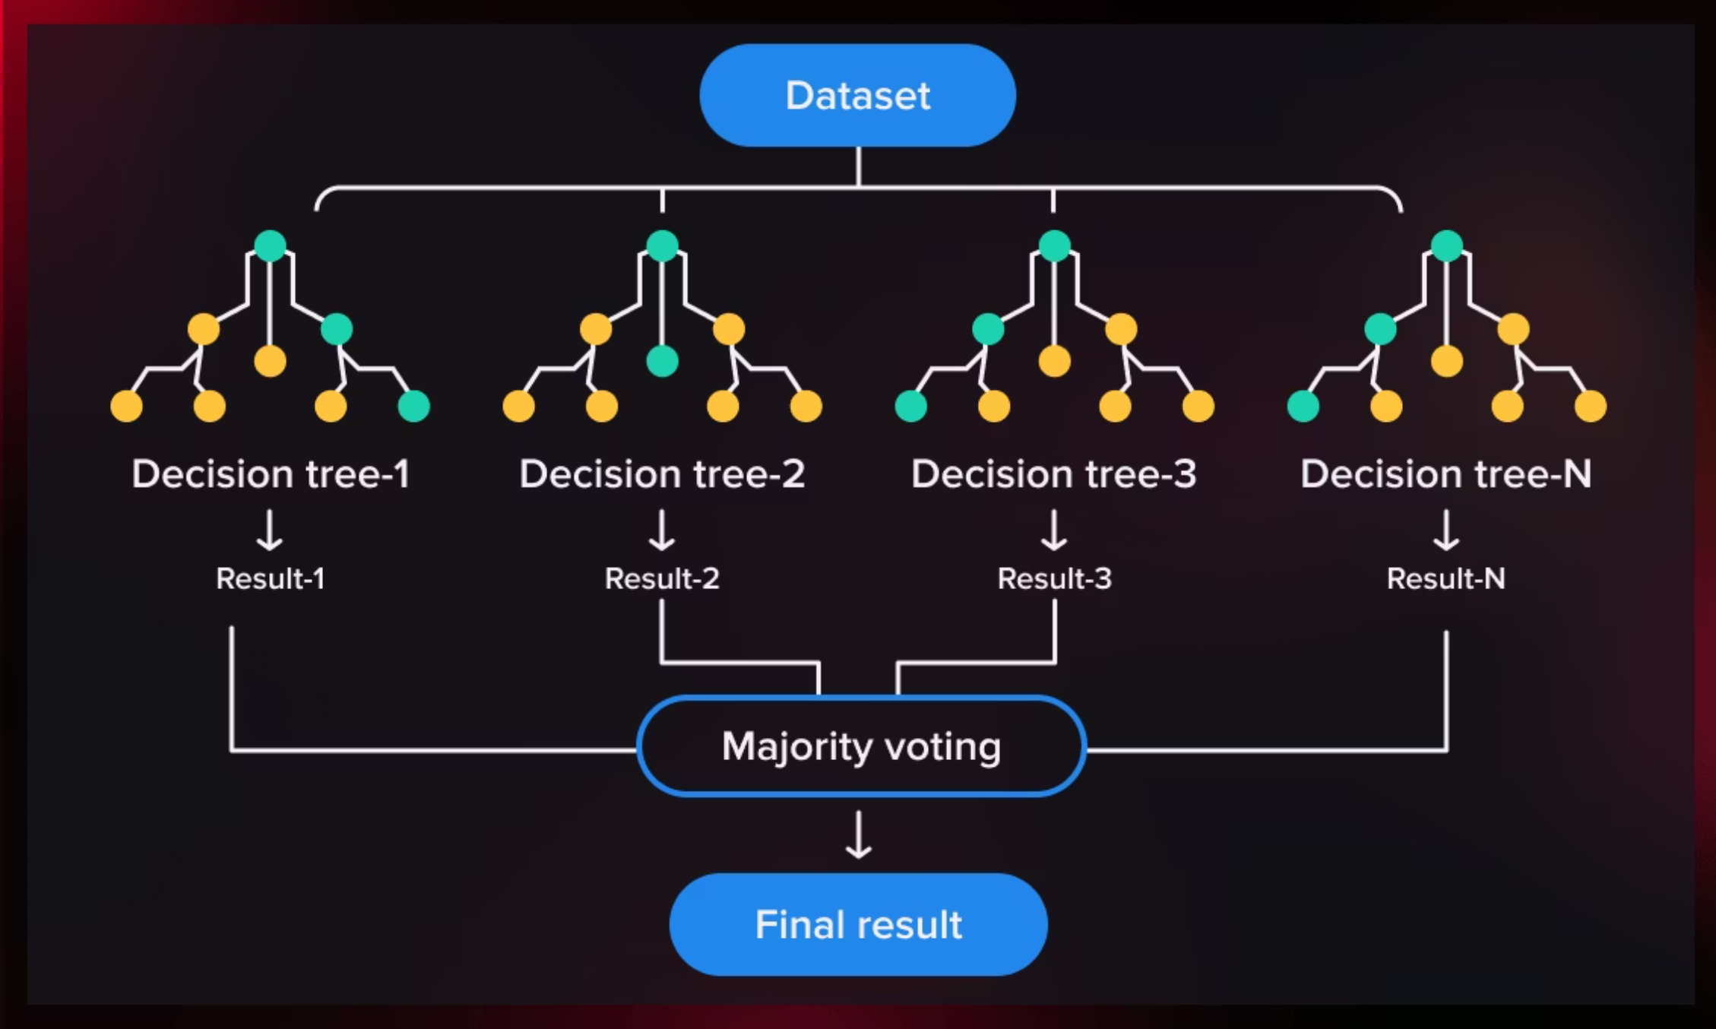
How Random Forest Works
Random Forest builds multiple decision trees during training, each using a random subset of the data and features. When making predictions, it aggregates the results from all trees—using majority voting for classification or averaging for regression—to produce a final output that is more accurate and stable than any individual tree.

Slide 6



What Random Forest Improves
Reduces Overfitting
Improves Generalization
Stable Predictions
By averaging predictions across many trees, Random Forest naturally smooths out individual errors and prevents memorization of training data noise
The model learns robust patterns that transfer well to new, unseen data rather than fitting too closely to training examples
Small variations in input data produce consistent outputs, making the algorithm reliable and trustworthy in production environments
These improvements make Random Forest particularly valuable when working with noisy data or when model reliability is critical for business decisions.

Slide 7



Where Random Forest Is Used
Random Forest has become a go-to algorithm across industries thanks to its versatility, accuracy, and ease of use. Here are some common applications:
Tabular Datasets
Classification Problems
Complex Regression
Excels with structured data in rows and columns—think customer databases, financial records, and sensor readings
Identifies which category an observation belongs to with high accuracy across diverse domains
Predicts continuous values even when relationships are nonlinear and feature interactions are intricate
Customer churn prediction
Email spam detection
Real estate price prediction
Credit risk assessment
Medical diagnosis support
Demand forecasting
Quality control in manufacturing
Fraud detection in transactions
Environmental modeling

